Slide 1
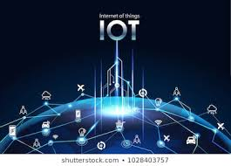
IOT Based River Water Quality Monitoring System Using IBM Watson PRESented by… p.v.b.ganesh p.v.b.kumAR CH.NAGA SUPRIYA

Slide 2
INTRODUCTION
Water pollution is one of the biggest fears for the green globalization.
In order to ensure the safe supply of the drinking water the quality needs to be monitor in real time.
In this project we present a design and development of a low cost system for real time monitoring of the water quality in IOT.

Slide 3
The system consist of several sensors used to measure physical and chemical parameters of the water.
The parameters such as temperature, PH, turbidity, flow sensor of the water can be measured.
The measured values from the sensors can be processed by the core controller.
The Arduino model can be used as a core controller. Finally, the sensor data can be viewed on internet using WI-FI system.

Slide 4
EQUIPMENT USED
SENSORS USED:
pH sensor
Turbidity sensor
DEVICES:
NodeMCU

Slide 5
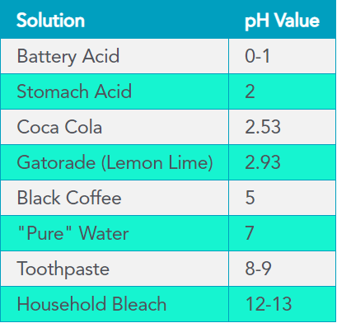
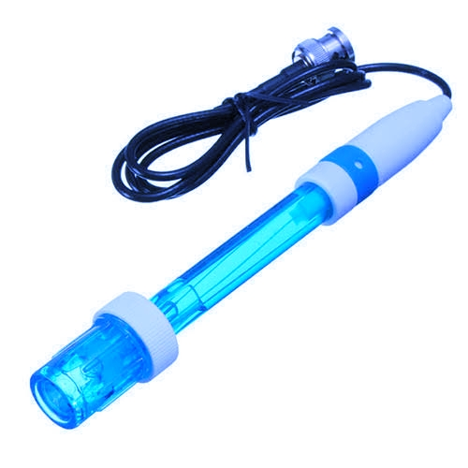
pH Sensor

Slide 6
pH Sensor
The pH of a solution is the measure of the acidity or alkalinity of that solution.
The pH scale is a logarithmic scale whose range is from 0-14 with a neutral point being 7.
Values above 7 indicate a basic or alkaline solution and values below 7 would indicate an acidic solution.
It operates on 5V power supply and it is easy to interface with arduino.
The normal pH range of water is 6 to 8.5.

Slide 7
pH Sensor APPLICATIONS
Common Applications:
pH neutralization of effluent in industrial manufacturing environments
Cooling tower and boiler control
Environmental monitoring
Odor scrubbers
Food and beverage quality control and safety
Upstream protection of filtration membranes
Water pre-treatment for manufacturing processes
Swimming pool control
Pulp and paper manufacturing
Pharmaceutical research & development and manufacturing
Blood-gas analysis in medical devices

Slide 8
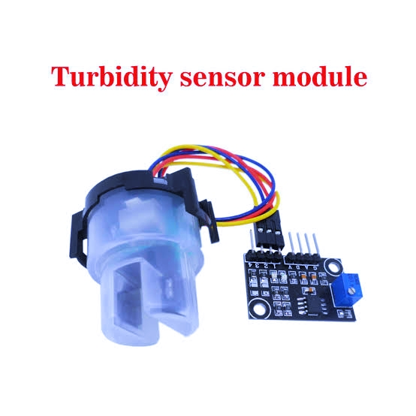
Turbidity Sensor The arduino turbidity sensor detects water quality by measuring level of turbidity. It is able to detect suspended particles in water by measuring the light transmittance and scattering rate which changes with the amount of total suspended solids (TSS) in water.

Slide 9
Turbidity Sensor
Turbidity is a measure of the cloudiness of water.
Turbidity has indicated the degree at which the water loses its transparency.
It is considered as a good measure of the quality of water.
Turbidity blocks out the light needed by submerged aquatic vegetation.
It also can raise surface water temperatures above normal because suspended particles near the surface facilitate the absorption of heat from sunlight.

Slide 10
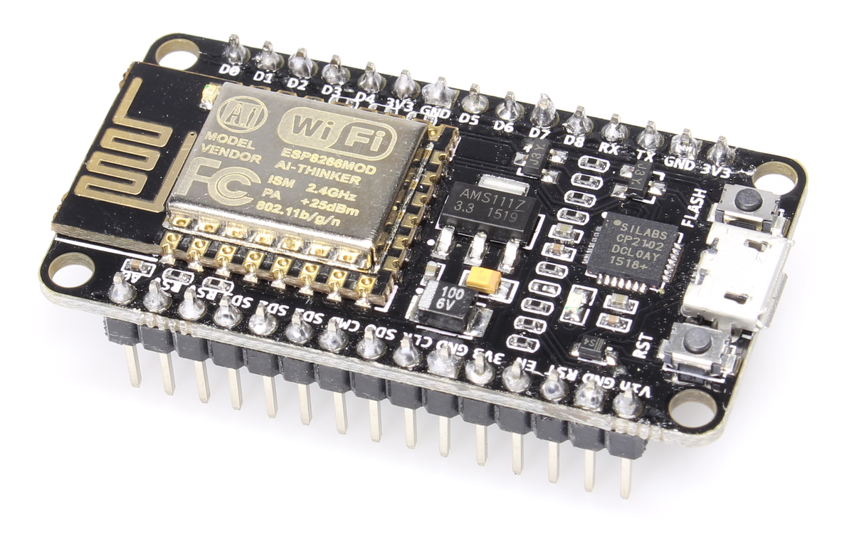
NodeMCU

Slide 11
NodeMCU
The ESP8266 Wi-Fi Module is a self contained SOC with integrated TCP/IP protocol stack that can give any microcontroller access to your WiFi network.
The ESP8266 is capable of either hosting an application or offloading all Wi-Fi networking functions from another application processor.
Each ESP8266 module comes pre-programmed with an AT command set firmware.
The ESP8266 module is an extremely cost effective board with a huge, and ever growing, community.

Slide 12
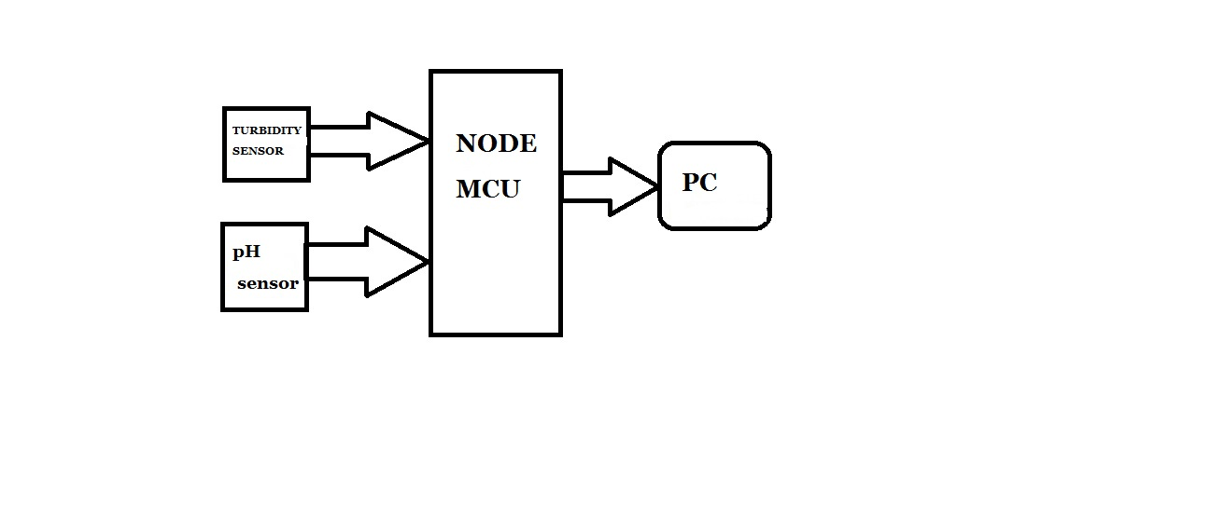
Block diagram

Slide 13
WORKING
The implementation of this model consists of different sensor devices and other modules, their functionalities are discussed above.
In this implementation model we use Wi-Fi module. And
Wi-Fi module connects the embedded device to internet.
Sensors are connected to node mcu for monitoring, it will convert the corresponding sensor reading to its digital value and from that value the corresponding environmental parameter will be evaluated.
After sensing the data from different sensor devices, which are placed in particular area of interest.
The sensed data will be automatically sent to the web server, when a proper connection is established with sever device.

Slide 14
CONCLUSION
Monitoring of Turbidity, PH & Temperature of Water makes use of water detection sensor with unique advantage .
The system can monitor water quality automatically, and it is low in cost and does not require people on duty.
So the water quality testing is likely to be more economical, convenient and fast.
The system has good flexibility.
Only by replacing the corresponding sensors and changing the relevant software programs, this system can be used to monitor other water quality parameters.
The operation is simple.

Slide 15
THANK YOU…

